Slide 1
Hotel Review Classification
Submitted By:
Akshay B R
Sumedh Avinash Chavan
Swatipriya Mohapatra
Siri. K. S
S. Mohan Vishnu
Md Faiz Kounain
Sriram M S

Slide 2
Contents
Introduction – The need for hotel review classification
Data Pre-processing and details
EDA – Visualization
Model Building
Model Evaluation
Deployment

Slide 3
Introduction
The major idea of the hotel review classification is for the people who are in need to stay in hotels when needed, the reviews might help the customers or travelers who are looking for a room or hotel. Hotel Reviews are a gold mine of customer insights for any hotel business.
By looking at the reviews we can understand which elements of their hotel influence more in forming a positive review or improves hotel brand image.
Also, its importance increases by many folds since majority of the future customers rely on reviews while finalizing their stay in this study, we will analyze the hotel reviews based on the aspects of the rating and review text.

Slide 4
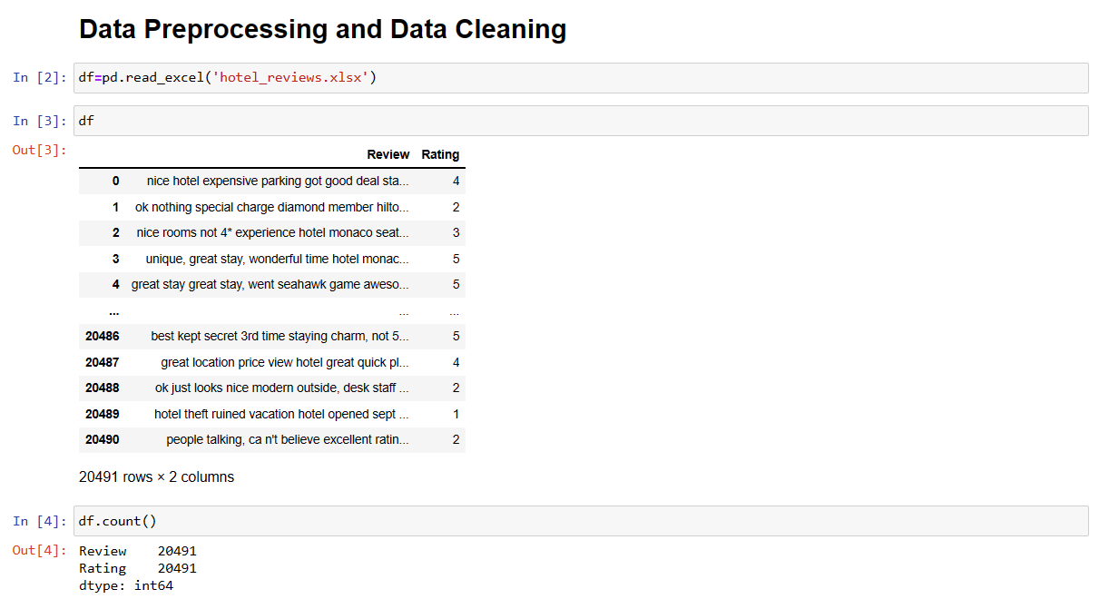
Data Pre-processing
We can see the uploaded dataset, with 20491 rows and 2 columns namely.

Slide 5
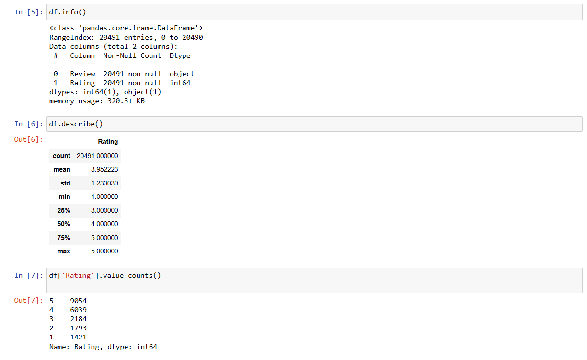
To clean the data – there are no duplicate or null values.
So, we go for the value counts which gives us the ratings from each category.
The info and the description of the dataset is given below.

Slide 6
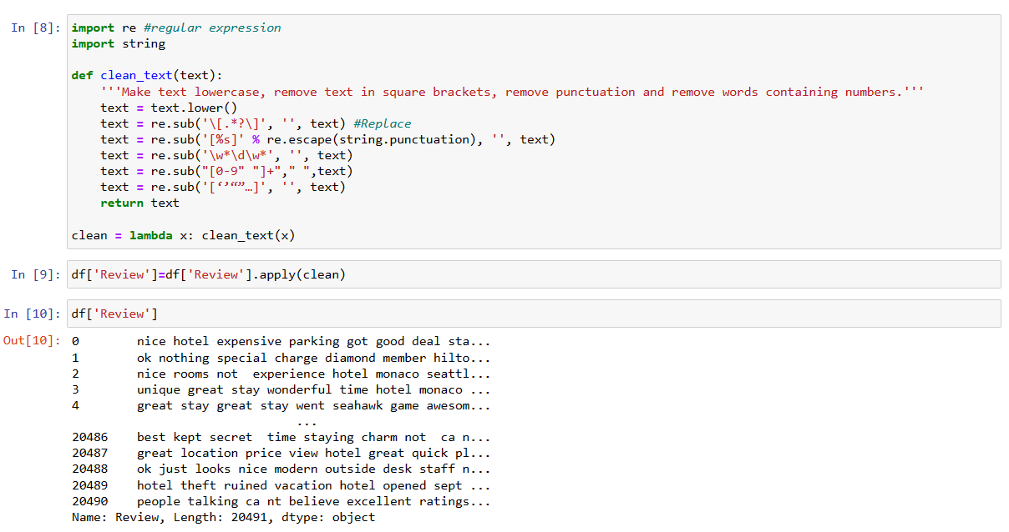
Now, we remove the punctuation marks, special characters from the dataset and make the data clean.
There are some words which may need to be removed, that are frequently repeated.

Slide 7
EDA – Visualization

Slide 8
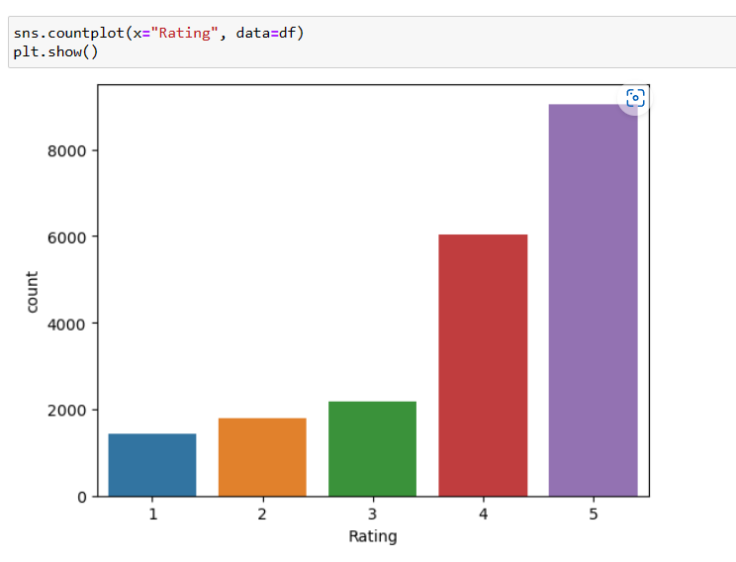
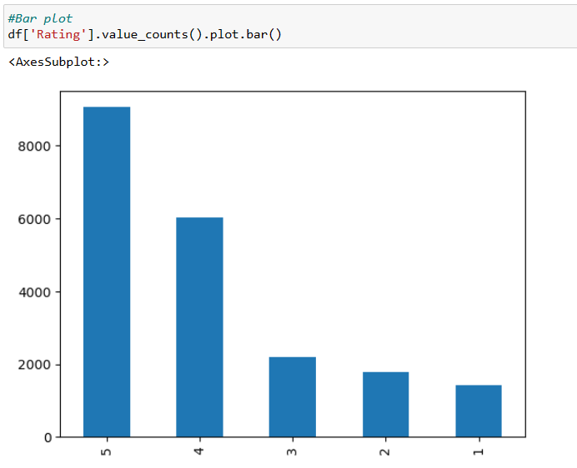
We can see the Count Plot and Bar Plot for the reviews that were made.
Count Plot
Bar Plot

Slide 9
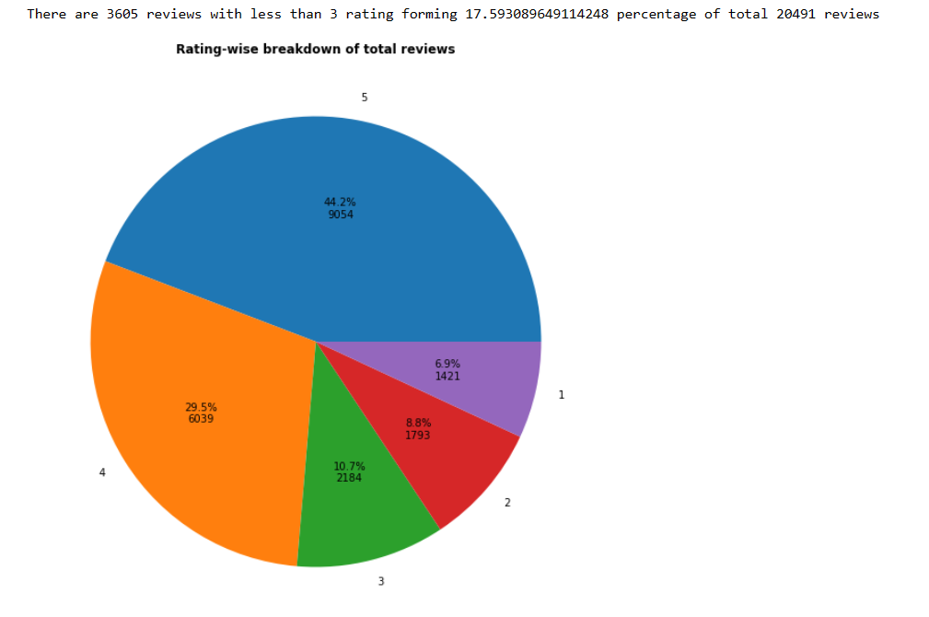
The Pie chart

Slide 10
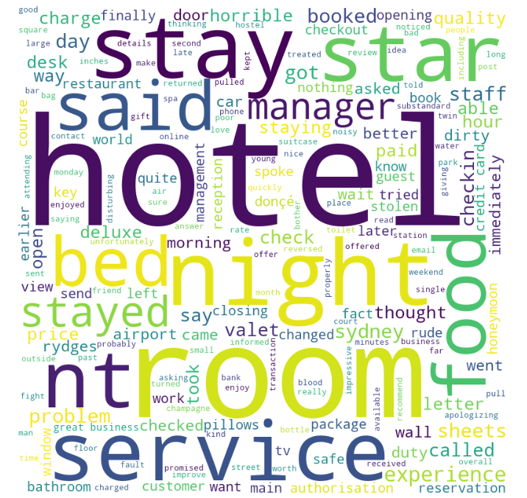
A Word Cloud is a visual representation of the most common words found in a text. The most frequently used words are displayed in larger font sizes, while less frequently used words are displayed in smaller font sizes. The word cloud can be useful for quickly identifying the main themes or topics that are present in a large amount of text.
Word Cloud for rating 1

Slide 11
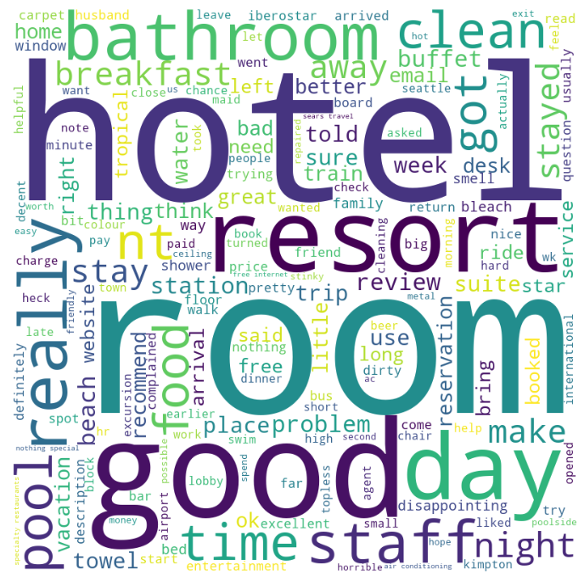
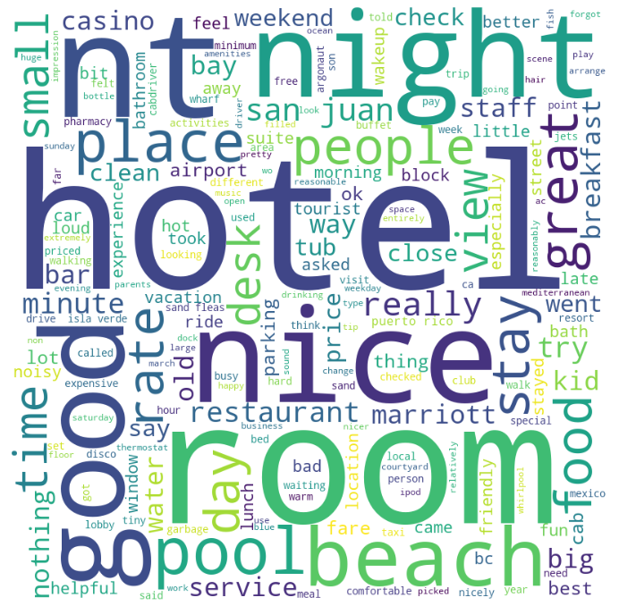
Word Cloud for rating 2 and 3.

Slide 12
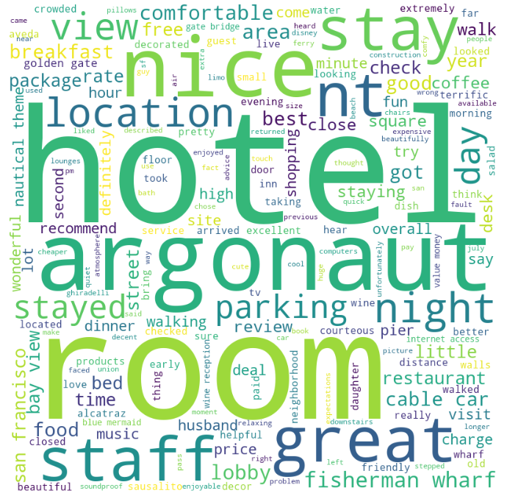
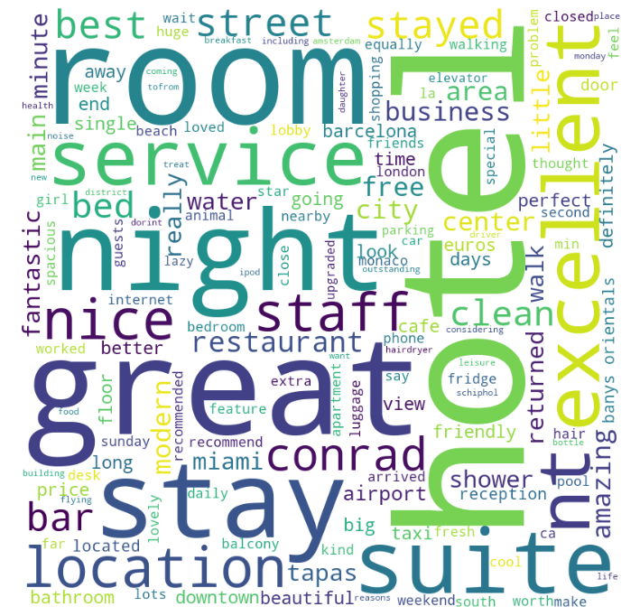
Word Cloud for rating 4 and 5.

Slide 13
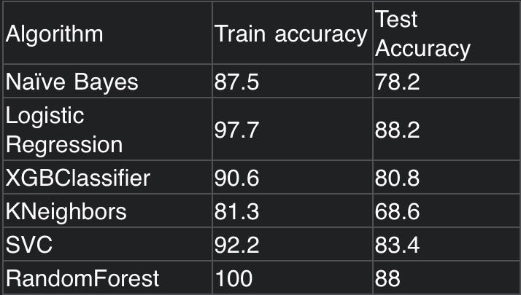
Model Building
In the model building for the Hotel Review Classification system we have used two types of approaches, they are:
Based on the words.
Based on the ratings.
In the below table we can see the different algorithms that can be used and the test accuracy.

Slide 14
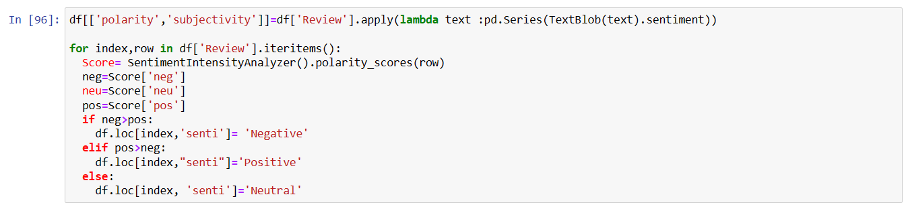
Model Building – Based on the words
We build this model based on the words that are given in the rating.
In the below code we can see that we have used “TextBlob” for the sentiment.

Slide 15
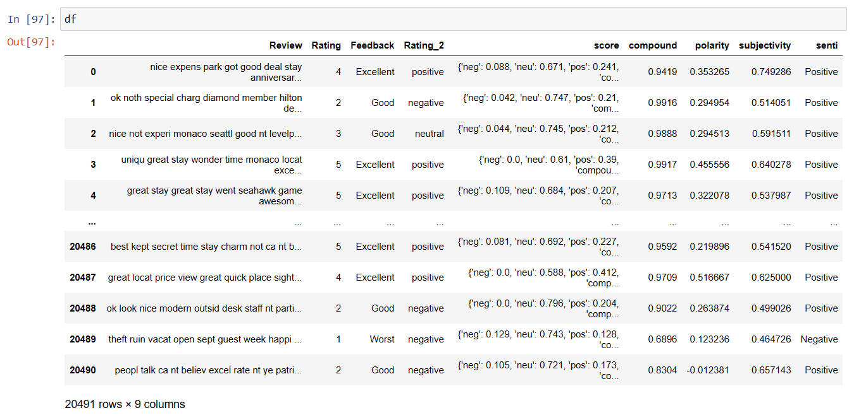
The output of the “TextBlob”

Slide 16
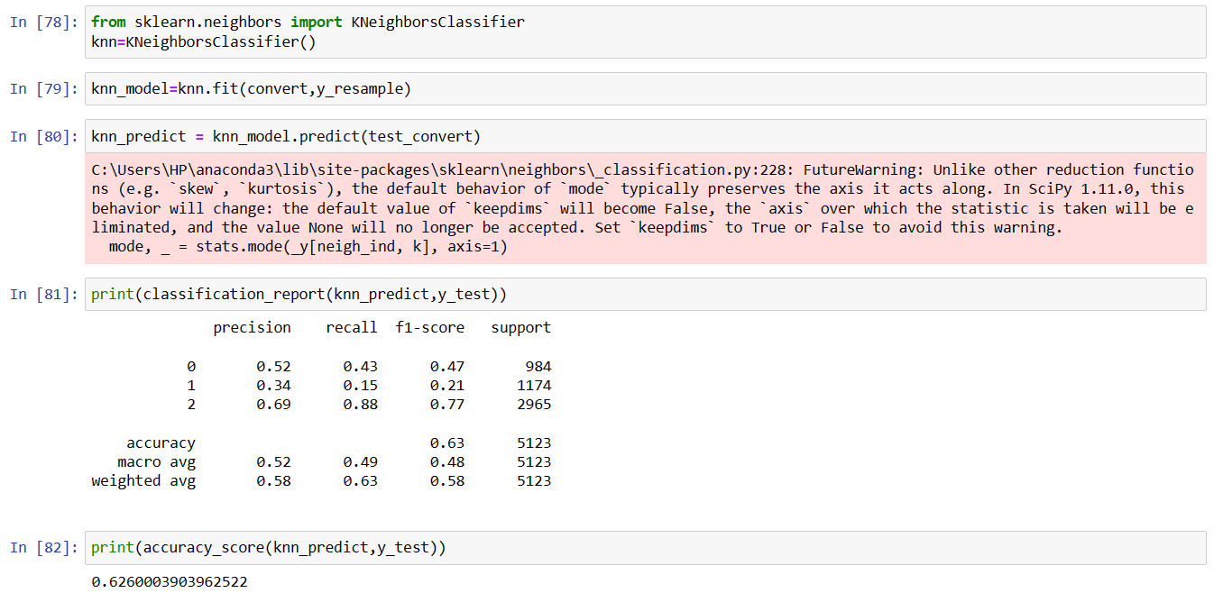
Model Building – Based on the Ratings
We use KNN and LightGBM.
The KNN model is used along with the accuracy, test and train data

Slide 17
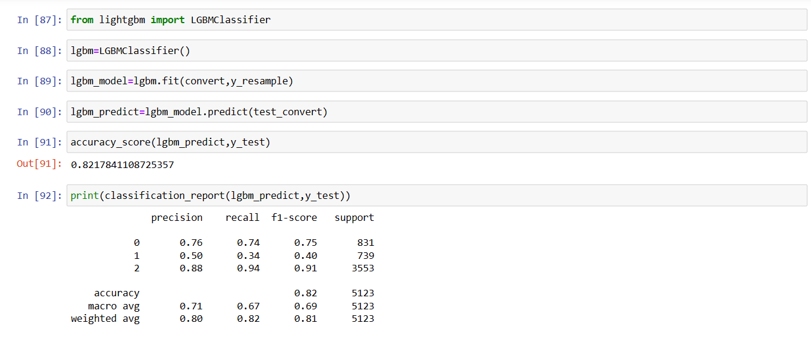
LightGBM is a gradient boosting framework.
We use this LightGBM for the model building.

Slide 18
Deployment

